Slide 1

CAPSTONE PROJECT
Secure Data Hiding In Images Using Steganography
Presented By: Guruvishnukumar E R
Student Name : Guruvishnukumar E R
College Name : KLN College Of Engineering
Department : Computer Science Engineering(CyberSecurity)

Slide 2
OUTLINE
Problem Statement
Technology used
Wow factor
End users
Result
Conclusion
Git-hub Link
Future scope

Slide 3
Problem Statement
With the increase in digital communication, securing sensitive information is crucial. Traditional encryption methods protect data but make it obvious that encryption is being used. This project, Secure Data Hiding In Images Using Steganography, embeds secret messages within images using Least Significant Bit (LSB) encoding. The hidden data remains invisible to the human eye and is protected with a password for added security. This method ensures covert and secure data transmission, making it ideal for privacy protection.

Slide 4
Technology used
Programming Language: Python
Libraries:
OpenCV
NumPy
Platform: Cross-platform (Windows/Linux)
Tools: Anaconda(Jupyter Notebook)

Slide 5
Wow factors
Invisible Encryption – Unlike traditional encryption, this technique hides data inside images, making it undetectable to anyone unaware of its presence.
Password Protected Security – The hidden message is not just embedded but also secured with a passcode, ensuring only authorized users can decrypt it.
Dual Functionality – Works as both a security tool (for private communication) and a data-hiding technique (for watermarking or copyright protection).
Lightweight & Fast Processing – Implemented using OpenCV and NumPy, making it efficient and easy to run on low-resource devices.

Slide 6
End users
Users can securely transmit confidential messages without drawing attention, unlike traditional encryption.
Hidden data remains invisible to attackers, reducing the risk of unauthorized access or interception.
The process is simple, requiring only an image, a message, and a password for secure encryption & decryption.
The method requires no complex hardware and runs efficiently on any system using simple image files.

Slide 7

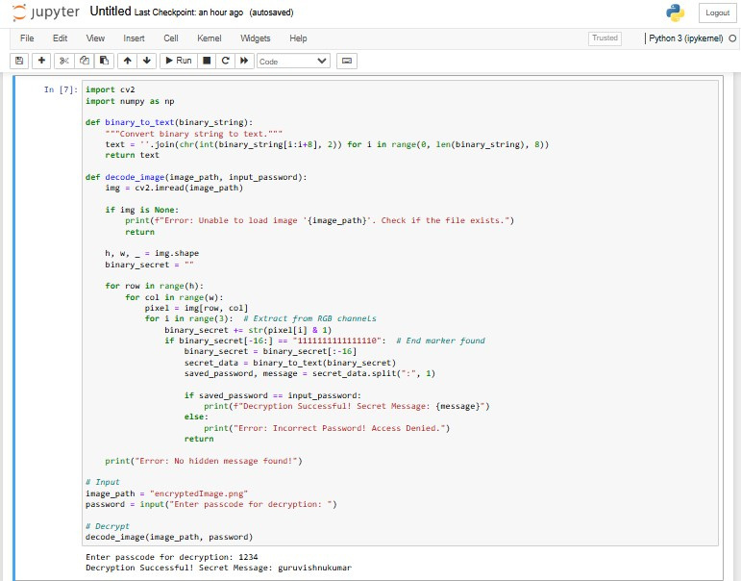
Results

Slide 8
Conclusion
The Secure Data Hiding in Images Using Steganography project provides an efficient and discreet method for concealing sensitive information within images. By utilizing Least Significant Bit (LSB) encoding and password protection, it ensures covert communication and enhanced data security. The technique maintains image quality while making the hidden message undetectable to unauthorized users. With its lightweight implementation and real-world applications in privacy protection, digital watermarking, and secure data transmission, this project serves as a practical and effective solution for secure information exchange.

Slide 9
GitHub Link
https://github.com/GuruVishnuKumar/Cybersecurity-Intern-Project

Slide 10
Future scope(optional)
Integration with Encryption Algorithms – Enhancing security by combining steganography with AES or RSA encryption for multi-layer protection.
AI-Based Steganalysis Resistance – Implementing adaptive encoding techniques to prevent detection by advanced AI-powered steganalysis tools.
Cloud & IoT Security Applications – Applying steganography for secure data exchange in cloud computing and IoT devices, ensuring confidentiality.
Steganography in Cybersecurity – Using the technique for secure authentication, digital forensics to prevent data tampering.

Slide 11
THANK YOU

